Slide 1
WCOLA 2019 Annual Meeting
August 17, 2019

Slide 2
Annual Meeting Agenda
WCOLA Mission
Confirm elections for President and Vice President
Committee Leads
Treasurers Report
Presidents Comments
Committee Chair Reports
Water Quality
Calendar

Slide 3
WCOLA Mission
The Wabana Chain of Lakes Association is dedicated to maintaining and improving the ecological environment of the lakes and lake shores in the Wabana Chain of Lakes and surrounding area in Itasca County. The Association will promote an atmosphere for friendship and community through expanded social interaction among it’s members and the surrounding lakeshore community.

Slide 4
2019 Elections
Elections 2019 for President and Vice President
Louie Gueltzow elected President
Steve Melin elected Vice President
150 ballots sent out
54 ballots returned – all voting to elect with no write-in candidates
Voting was again done both electronically and via mail

Slide 5
Board/Committee Leads
Tom Klatt Social Committee
Jean Melin Communications Committee
Mark Conover Environmental Committee
Doug Griffin Government Liaison
Roger Linder Historical Committee
Steve Melin Secchi Readings/Business Committee
Louie Gueltzow Business Committee
Jim Olijnek exofficio board member (1 Year)
Sherry Miner Social Committee Co Chair

Slide 6
WCOLA Treasurers Report
149 member households as of end July 2019, (now 152)
Beginning Balance-$7234 on January 1, 2019
Receipts-$5780
$4480 Dues
$810 Contributions
$130 Product sales
$ 360 Memorials
Expenses-$4050
Transfers-$1170 to designated funds
Checkbook balance-$7793 on 31 July
Designated funds
Water testing $6563
AIS emergency $7181

Slide 7
Presidents Comments
Membership remains solid
Financially healthy
Welcome packages
We are focused on Water Quality
Updated Water Quality Plan
AIS Rapid Response Plan
Resort/Camp Package

Slide 8
Reports
Government Liaison-Doug Griffin
Communications-Jean Melin
Social-Tom Klatt
Firewise-Louie Gueltzow
Secchi Readings-Steve Melin
Loon Count-Ken Zimmer
Road Clean-up-Barbara Zimmer
Historical-Roger Linder
Business-Louie Gueltzow
Environmental-Mark Conover

Slide 9
Government Liaison
Itasca County Soil & Water Conversation District
Provides, trains, schedules watercraft inspectors at Lake accesses
Provides information for free watercraft decontamination on website
MN Department of Natural resources
Fish studies and fish stocking
AIS enforcement
Some lake use enforcement, shoreline, fishing laws, watercraft use
Itasca County Sheriff’s office
Law enforcement
What we as association members can do to ensure that the above agencies can do their jobs efficiently and unencumbered

Slide 10
Communications
Responsible for:
Three member newsletters per year
Annual membership letter sent in January
Expanded communications to members and entire lake community through the Wabana Chain of Lakes Association (WCOLA) Facebook page https://www.facebook.com/wcola.org/
and WCOLA website https://wcola.org/

Slide 11
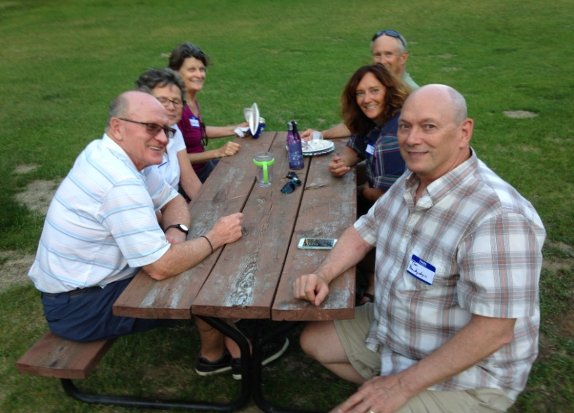
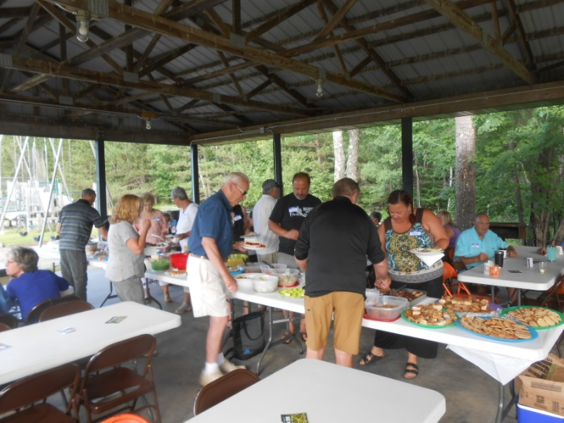
Social Committee
Two main Activities/year
Spring Social Kick-off was held on June 9 at Bluewater Camp again this year-70 attended
Annual outdoor Picnic at Wabana Pavilion on July 28th. 57 attended

Slide 12
Firewise

Slide 13
Secchi Readings
Readings are made by volunteers
Wabana - 6 locations
Wakeman Bay – 1 location
Little Wabana – 1 location
Bluewater – 2 locations
Trout – 3 locations
Little Trout – 2 locations
Need additional readers on Trout, only a few readings were taken

Slide 14
Secchi Readings

Slide 15
Loons
Annual count completed July 18
Counters are:
Trout and Little Trout Paul Oberg
Bluewater and Wakeman Bay Denny Koewler, Steve Melin
Wabana Ken Zimmer and Cress Hart

Slide 16
WCOLA Loon Count
2019
5/0
19/1
10/0
1/0
2/0
35/1/2
Adults
2017 count
4/2
16/5
14/1
2/1
--
36/9
2018
4/3
35/8
19/0
2/1
--
60/12
90
2014 count
2015 count
2016 count
Bluewater 6/2
7/0
4/1
Wabana 22/3
21/3
30/3
80
Trout 40/2
39/0
36/0
Little Trout 1/0
2/2
2/1
Little Wabana - 2/1
--
70
Total 69/7 71/6
72/5
60
Adults
Chicks
50
12
40
Chicks
6
0
0
2003
05
06
04
07
08
09
10
11
12
13
14
15
16
17
18
19
20

Slide 17
Road Clean-up
WCOLA sponsors road clean-up on Wabana township roads in May and September each year
Barbara Zimmer is our coordinator with the Itasca County engineer
The County Engineer’s Office provides vests, trash bags and pick-up of gathered trash
The fall event is on Wednesday September 25

Slide 18
Historical Committee
Formed over 10 years ago
Two major projects
Many years of newsletter articles and photos lead to the table display in the town hall
Loaded a Picture Frame as a digital display for viewing at WCOLA events
Lots more can be done, volunteers needed with ideas and enthusiasm
Call Roger Linder 218 326-2266

Slide 19
Business
Completed annual financial audit 2018
Established nominating committee
Completed election process
Established budgets for each Committee
Monitoring spending vs. budget plans
Working on Possible insurance concerns
Received a grant for $500 from Medtronics in August
How we spend association money

Slide 20
WCOLA 2019 spending to date
Environmental including AIS Inspections 65%
Communications 15%
Business 15%
Social Events 1%
Government Liaison 4%
Plus we have dedicated $6563 for 2020&2021 water chemical testing and $7180 for emergency AIS treatment

Slide 21
WCOLA Environmental Committee
Mission Statement
Promote environmentally sound practices on the water and surrounding land
Cooperate and coordinate with governmental agencies and other lake associations
Goals
Maintain excellent water quality
Manage the spread of Aquatic Invasive Species

Slide 22
Water Quality Plan
Water testing-chemical and clarity
Secchi Readings weekly/biweekly at 10+sites
MPCA testing-done 2015 and 2016 5 times at 5 sites
Updated WCOLA Water Quality plan is in place
Emulate MPCA closely in protocol, sites, frequency each month for 5 months ice out through fall
WCOLA testing-2020 and 2021 at 7 sites, volunteers have been recruited for water sample collection
RMB will train volunteers, test samples and provide chemical analysis

Slide 23
Water Quality
Septic Systems education/communications
New septic program for financing via the county
Shore line education/communications
Shoreland Guide sent to all members
Building permit variance request monitoring
Coordinate with other organizations-Itasca Waters, ICOLA,DNR, Soil and Water, Sea Grant, etc
Lake Service Providers AIS Summit-Soil and Water
Five Star Program for certified lake service providers

Slide 24
Aquatic Invasive Species
Primary concern is zebra mussels and starry stonewort
although there are several others
Prevention-Boat/trailer inspections, Shoreline inspections
Resort/Camp information packages developed/delivered
AIS Rapid Response Plan complete
Permit account started with DNR
Emergency funds available to treat AIS
We have three AIS certified detectors-Jean Melin, Jean Panchyshyn, Jane Moore, two DNR and Five Star certified resorts-Birch Bay and Brittons on Trout, and two trained boat inspectors-Steve Bjerke and Gary Oja

Slide 25
Zebra Mussel migration
Additional Itasca waters infested so far in 2019
Water body name | County | AIS | Year Infested | Year Confirmed/ connected water | DOW number
Jay Gould | Itasca | Zebra Mussels | 2019 | Connected to Blandin Reservoir | 31-0565
Little Jay Gould | Itasca | Zebra Mussels | 2019 | Connected to Blandin Reservoir | 31-0566
Miss. River from Winnibigoshish to Miss. Lake | Itasca | Zebra Mussels | 2019 | Connected to Blandin Reservoir | N/A
Pokegama | Itasca | Zebra Mussels | 2019 | Connected to Blandin Reservoir | 31-0532
Blandin Reservoir | Itasca | Zebra Mussels | 2018 | 2018 | 31-0533

Slide 26
Calendar
2019
August 17-WCOLA annual meeting and Program
September 25-Road Clean-up
November 9-Hunters Supper sponsored by Wabana Community fund
2020
May Water sampling begins
May 6 -Road Clean-up
June 13-Kick-off Social
June-Downing’s Summer Solstice Party
July 4-Boat Parade
July 18-Annual Picnic
August 15-Annual Meeting and Program
September 23-Road Clean-up

